Slide 1

Navigating the national Institutes of health (NIH)
Annette Owens-Scarboro
Program Manager/HBCU Coordinator
July 25, 2022
Notes:
NIH has external support to build the capacity of the PEI Initiative to be a successful contracting competitiveness incubator for HBCUs.
NIH is out front among other Federal agencies participating in the White House Initiative on HBCUs.
The PEI Initiative consistently hosts a Federal HBCU Industry Day and other activities during the Annual HBCU Week Conference, and the Chairman of President Biden’s Advisory Board for HBCUs is the President of Delaware State University, a participant in the PEI 2.0 Cohort.

Slide 2
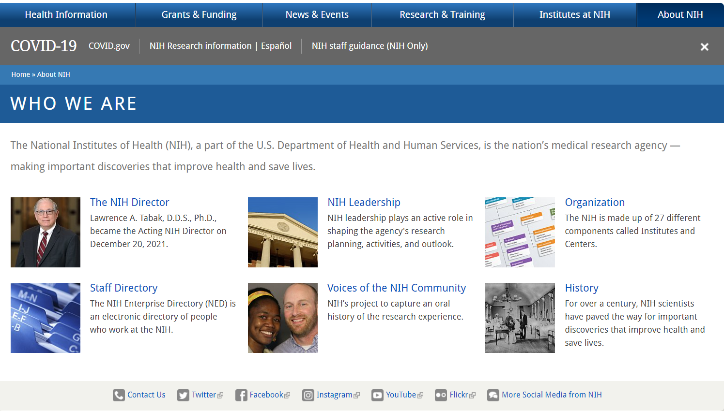
Who Are We? The nih!

Slide 3
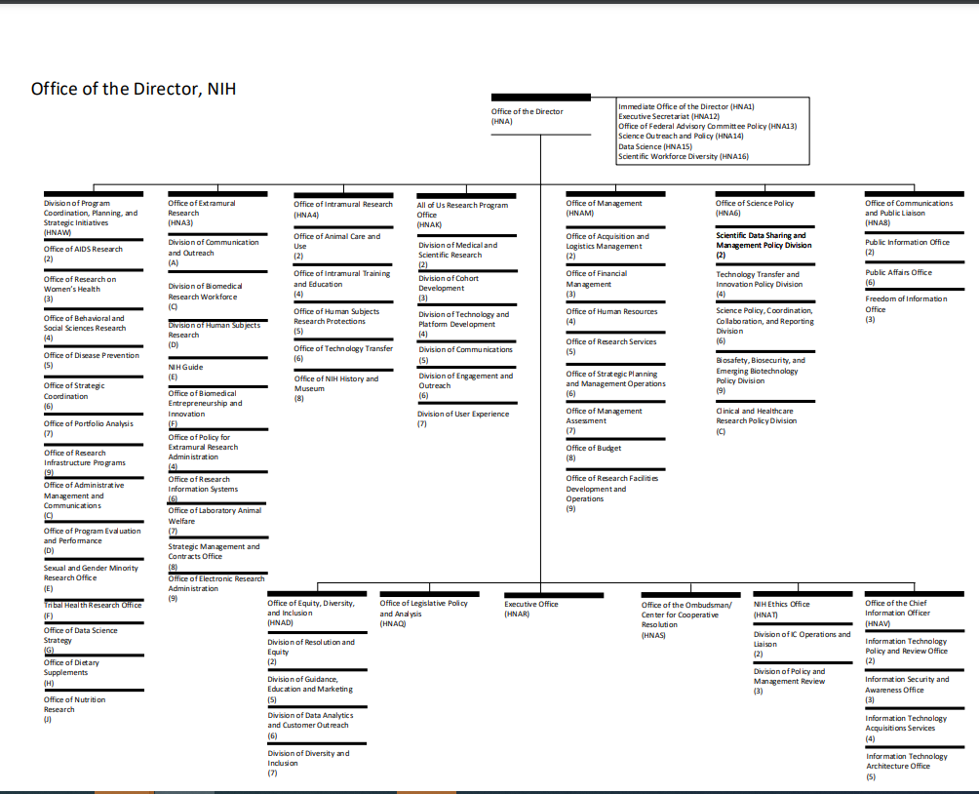
NIH Organizational Structure

Slide 4
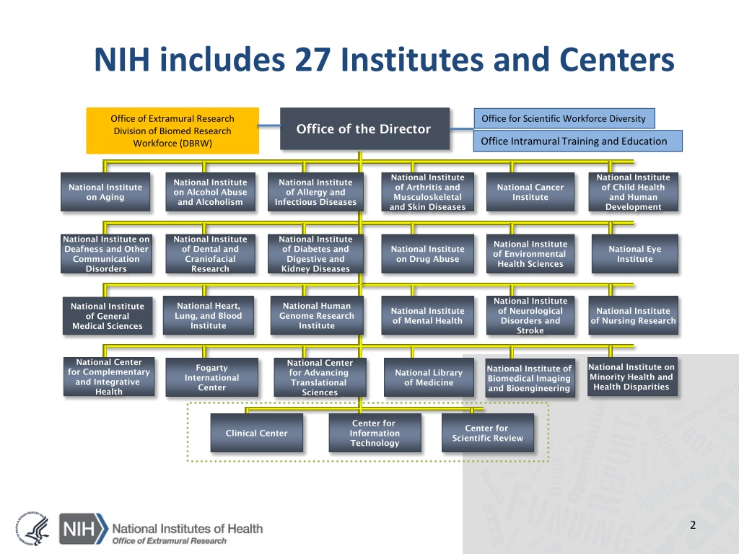
NIH Includes 27 institutes and Centers

Slide 5
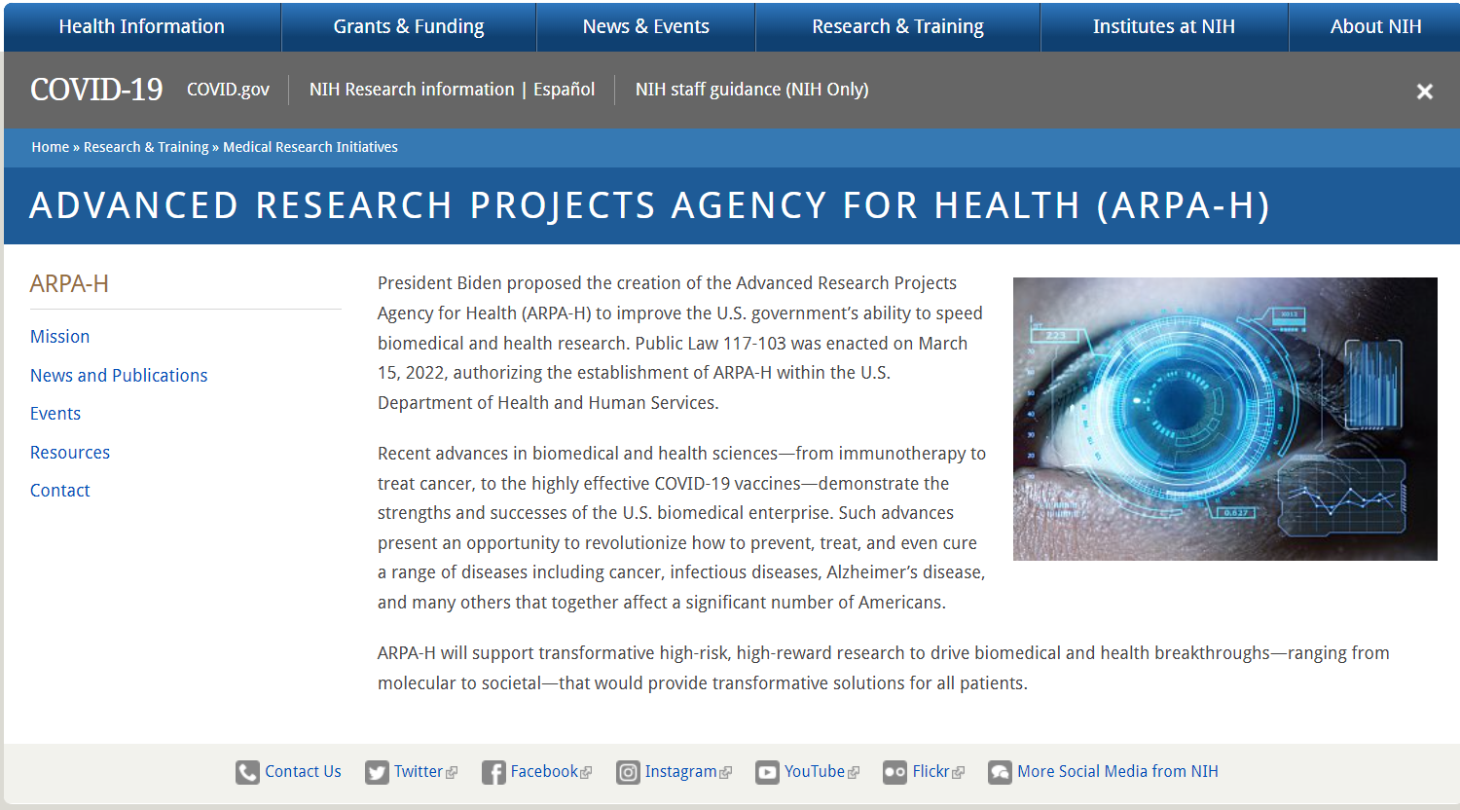
ADVANCED RESEARCH PROJects Agency for health (Arpa-h)

Slide 6
One nih, 27 Cultures
Each IC has its own mission
Each IC has its own budget
Each IC has its own activities
Each IC has its own way of doing business
So, how do you figure out WHERE to start?? Here’s some advice!

Slide 7
FY 2020 Operating budget: ~$40B
Training: $886,806
Career: $844,348
Total: $1,731,154
NIH Budget Office: http://officeofbudget.od.nih.gov/index.htm

Slide 8
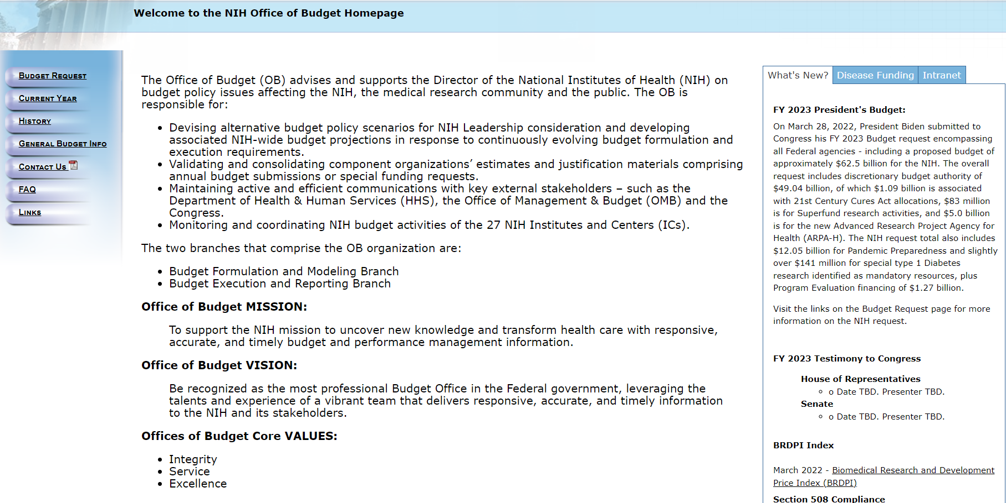
NIH Office of budget

Slide 9
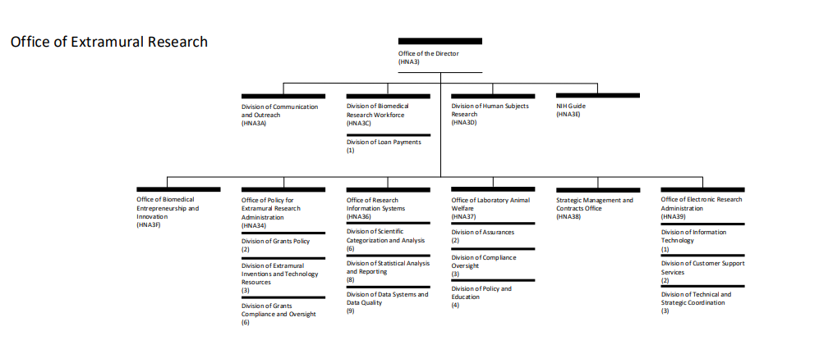
NIH Organizational Structure

Slide 10
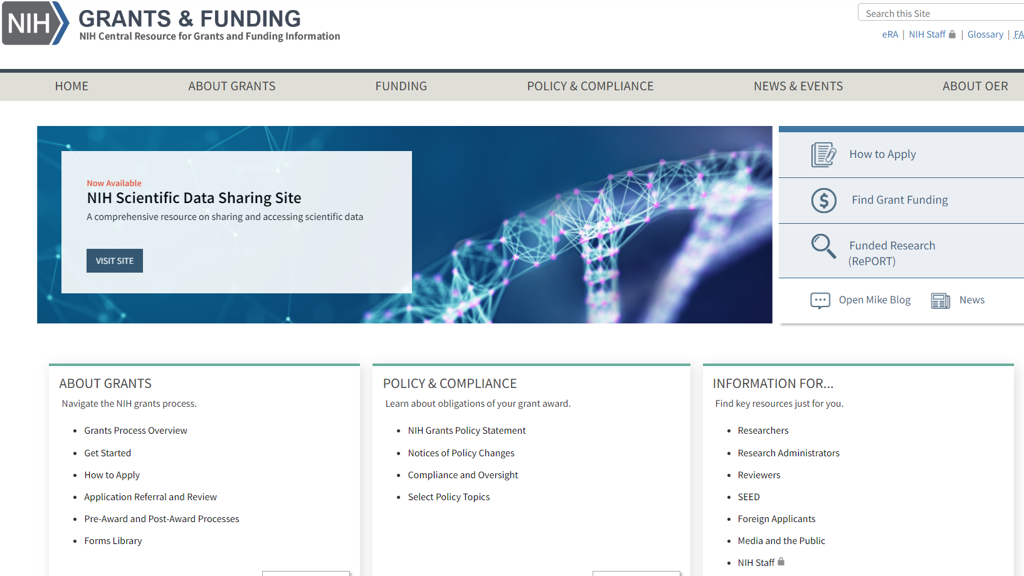
Office of extramural research

Slide 11
Interacting with NIH
NIH Staff
Program
Officer
Scientific Review Officer
Grants Management Officer
Scientist & Administrator
Identifies areas of scientific need
Communicates NIH priorities to investigators and others
Manages grants
Communicates with IC Leadership about the science
Scientist & Administrator
Manages grant reviews
Appoints members to review groups & panels
Prepares summary statements
Implements the funding process
Oversees the budget
Ensures grantee compliance with NIH policies & regulations

Slide 12
Who Should I talk to? When? And About What?
NIH People
Program Officer
Scientific Review Officer
Grants Management Officer
Before applying discuss
  Concept paper aims & fit with NIH priorities
  Appropriate funding mechanism
  Responsiveness to review criteria
  After Review to discuss next steps
After application is assigned to a review committee until review is complete to discuss:
  Review committee selection
  Missing info
  Supplemental info
Before or after review to discuss:
  NIH grants policy
  Budget
  Change of institutions
  Grant start dates

Slide 13
NIH Small Business Program Office vs.
NIH SBIR/STTR Office
NIH Small Business Program Office
Small Business Act of 1953
Federal Acquisition Regulation pt.19
Assists small businesses with acquisition concerns
Advocates on-behalf of small businesses to the NIH acquisition community
Hosts vendor outreach forums, small business industry days, & newbie open forums.
NIH SBIR/STTR Office
SBIR/STTR Reauthorization as part of S.2943, the 2017 National Defense Authorization Act (NDAA)
Assists small businesses with the SBIR/STTR program
The most common SBIR/STTR awards (Phase I & II) are grant awards
Hosts the annual HHS SBIR/STTR Conference
Located in NIH, Office of the Director
Works with small businesses

Slide 14
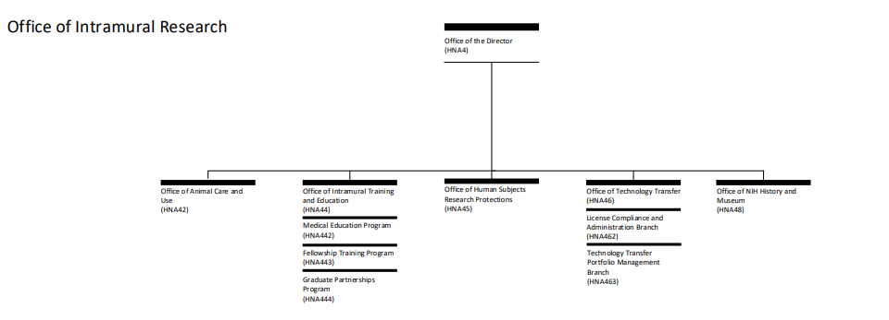
NIH Organizational Structure

Slide 15
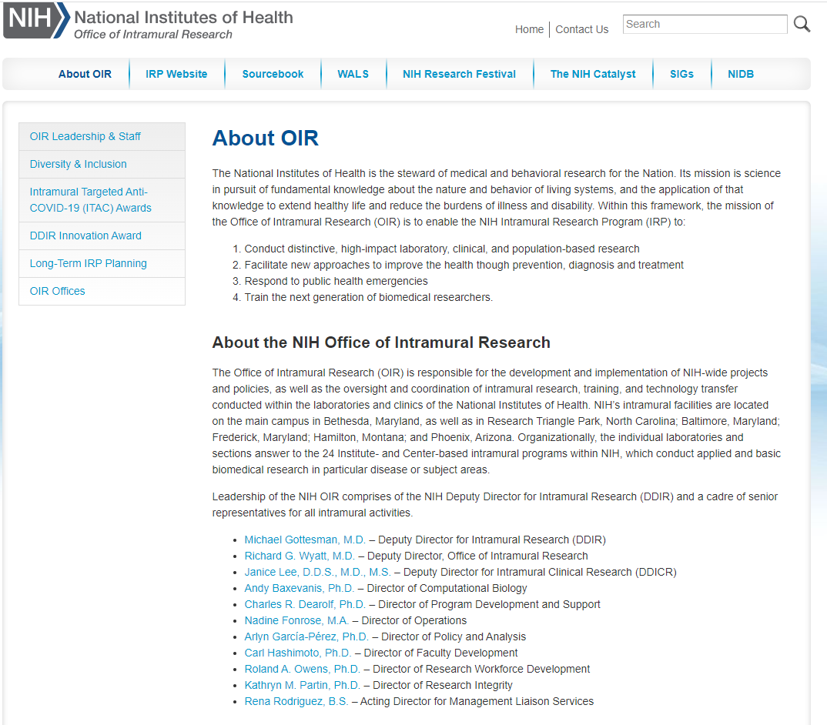
Office of intramural Research

Slide 16
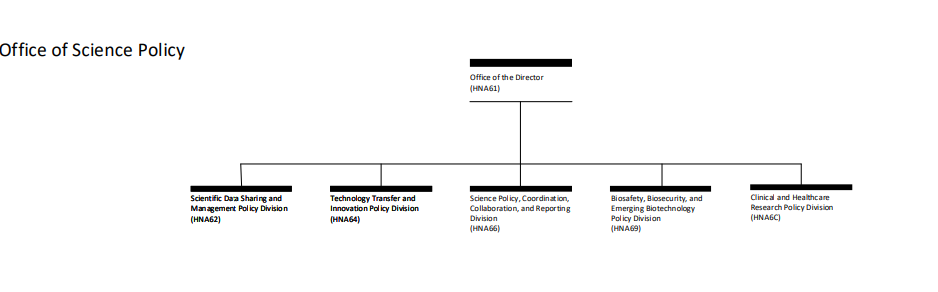
NIH Organizational Structure

Slide 17
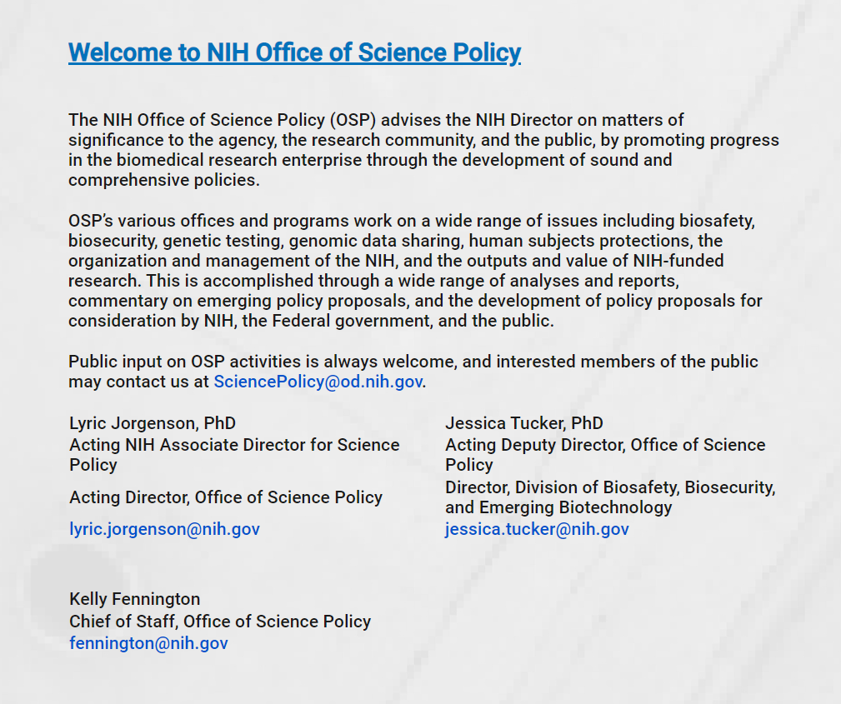
Office of Science policy

Slide 18
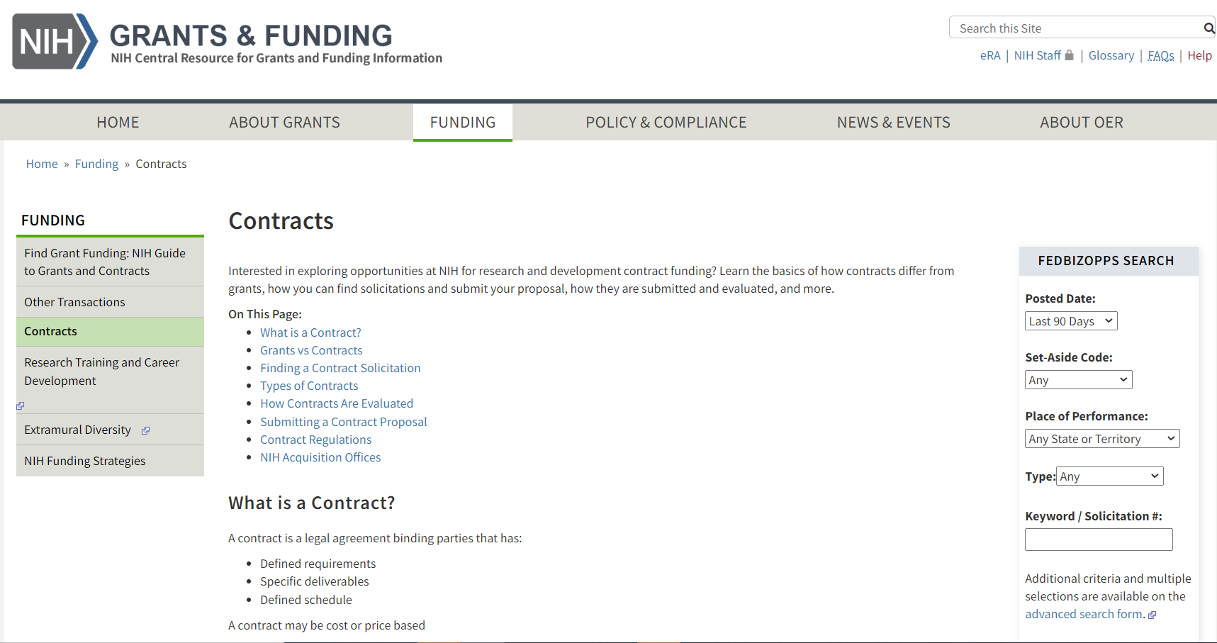
NIH Contracting

Slide 19
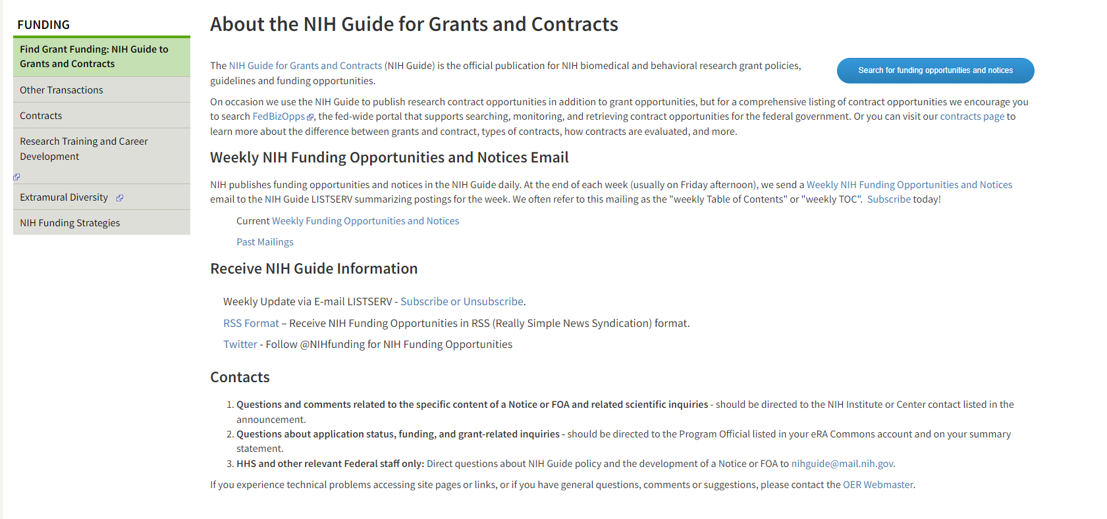
NIH guide for grants and contract

Slide 20
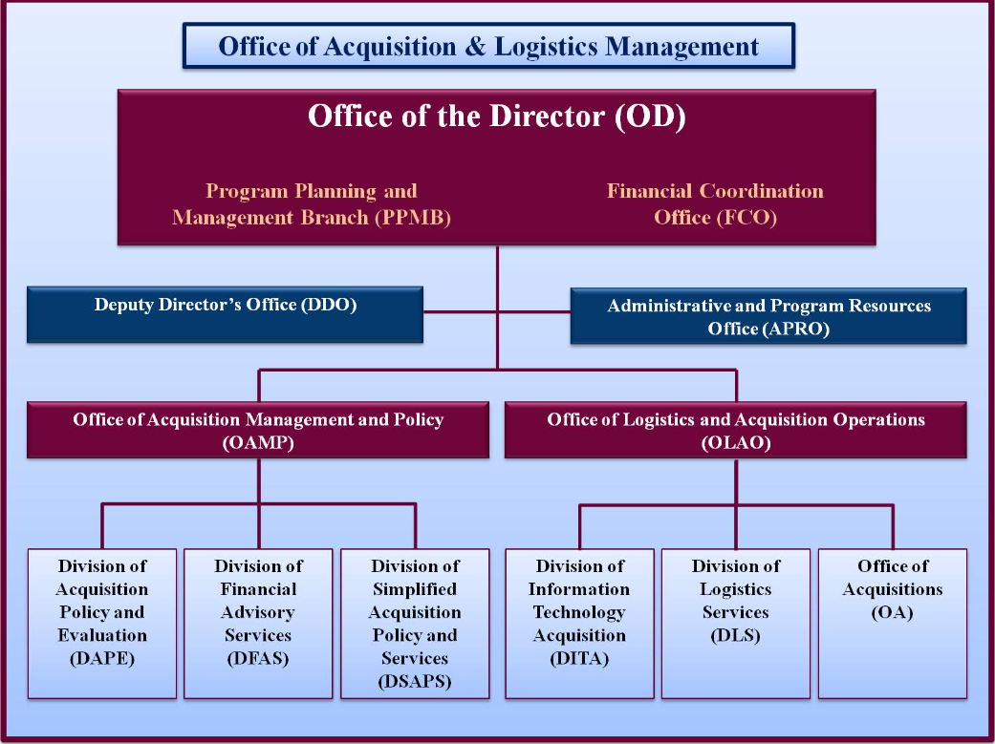
OALM HIERARCHICAL STRUCTURE

Slide 21
FY2021 NIH Acquisition Organization COACS SolAR CHART
National Heart Lung & Blood Institute
(NHLBI, NIAMS, CSR, NIDCR, NIBIB, NHGRI)
R&D $123M & Non-R&D $655M
Total: $779M
Ann Gawalt
National Institute on Drug Abuse
(NIDA, NINDS, NIMH, NIA, NCATS)
R&D $190M & Non-R&D $549M
Total: $739M
Christopher Belt
National Institute of Allergy & Infectious Diseases
(NIAID, HHS Biodefense)
R&D $1.07B & Non-R&D $305M
Total: $1.37B
Charles Grewe
NATIONAL INSTITUTES OF HEALTH
OFFICE OF ACQUISITION AND LOGISTICS MANAGEMENT (OALM)
Diane J. Frasier
Head of the Contracting Activity, NIH
Total: $7.90B
COAC: R&D Contracts: $2.51B & Non-R&D Contracts: $5.00B
DELEGATED: Purchase Card: $274M; Delivery/Task Orders & Purchase Orders: $88M; BPA Calls: $25M
National Cancer Institute
(NCI, NCCIH)
R&D $957M & Non-R&D $345M
Total: $1.30B
Francine Hemphill
Office of Research Facilities (ORF)
All NIH Facilities Related to Acquisitions
R&D $0M & Non-R&D $481M
Total: $481
Kala Shankar
Clinical Center (CC)
R&D $1.29M & Non-R&D $246M
Total: $247M
Susan Nsangou
National Library of Medicine
(NLM, CIT, OD)
R&D $1M & Non-R&D $602M
Total: $603M
Dan Hartinger
National Institute of Environmental Health Sciences (NIEHS)
R&D $84M & Non-R&D $76M
Total: $160M
Melissa Gentry
Office of Logistics & Acquisition Operations
(OLAO, NINR, NEI, ORS, NIDCD, NIGMS,
OD, NITAAC)
R&D $.723M & Non-R&D $1.11B
Total: $1.12B
Darnese Wilkerson
NITAAC: $401M
Acting: Brian Goodger
National Institute of Child Health & Human Development
(NICHD, NIAAA, FIC, NIDDK, NIMHD)
R&D $84M & Non-R&D $227M
Total: $311M
Marlene Mireles

Slide 22
FY2021 Breakdown of Solar chart
COACs | IC Customers | R&D Total Obligations | Non-R&D Total Obligations | TOTAL R&D and Non-R&D
CC | CC | $1.29M | $246M | $247M
NCI | NCI and NCCIH | $957M | $345M | $1.30B
NHLBI | NHLBI, CSR, NIAMS, NIDCR, NIBIB, and NHGRI | $123M | $655M | $779M
NIAID | NIAID, and HHS BIODEFENSE | $1.07B | $305M | $1.37B
NICHD | NICHD, NIAAA, FIC, NIDDK, and NIMHD | $84M | $227M | $311M
NIDA | NIDA, NINDS, NIMH, NIA, and NCATS | $190M | $549M | $739M
NIEHS | NIEHS | $84M | $76M | $160M
NLM | NLM, CIT, NIH-OD | $1M | $602M | $603M
OLAO - NITAAC | OLAO [NITAAC: Services all NIH & OLAO: NIH Wide Vehicle Branch], NEI, NIDCD, NIGMS, ORS, NIH-OD, and NINR | $.723M $0M | $1.11B $401M | $1.12B $401M
**ORF | ORF and ALL NIH FACILITIES RELATED ACQUISITIONS | $0M | $481M | $481M
Head of the Contracting Activity (HCA) – Total $7.90B: COAC – R&D $2.51B; Non-R&D $5.00B. Delegated: P-CARDS = $273M (includes credits). DELEGATED $113M (DO/TOs & POs $88M + BPA Calls $25M).
**ORF – Leases (PSC X1**) = $80M. This figure is included in the ORF Non-R&D Total of $481M.
Chart 11.1

Slide 23

What Nih buys: Services
  Consulting
  Studies
  Conferences
  Training
  Planning
  Technical Assistance
  Clearinghouse
  Data Collection/Analysis
  Logistical and Management Support
  Evaluations
  Biomedical Research
  Public Awareness Programs

Slide 24
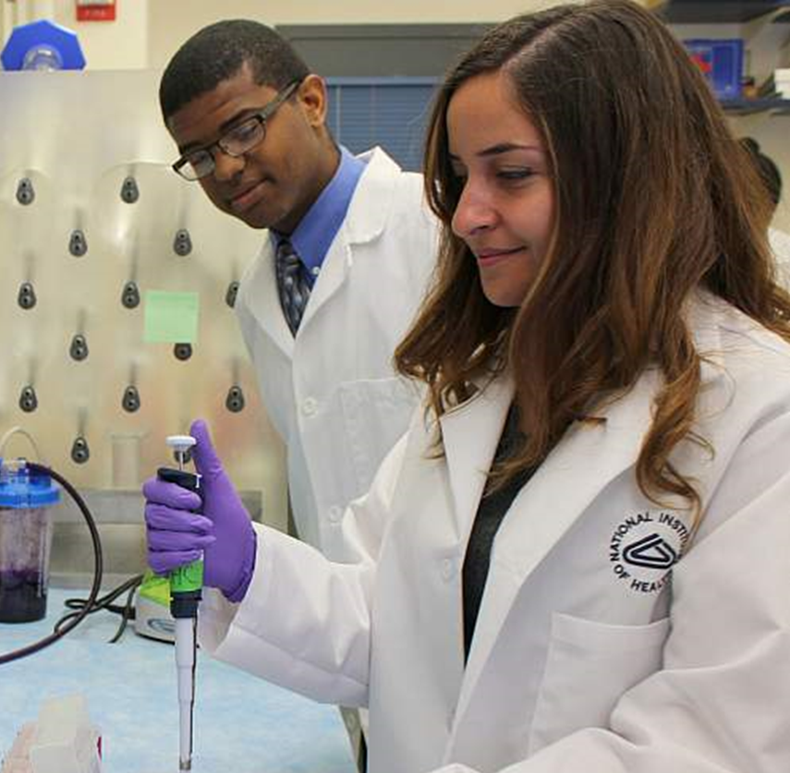
What Nih buys: Research and development
  Most of the contract obligations
  stem from:
  Clinical Trials
  Pharmacological studies
  Genetics and Biology
  Investigations
  Vaccine Development and Testing
  Environmental Research

Slide 25
NIH Information Technology Acquisition & Assessment Center (NITAAC):
https://nitaac.nih.gov/
CIO-SP3
Everything IT!
Services and Solutions Across
10 Task Areas
1. IT Services for Biomedical Research Health Science & Healthcare
2. Chief Information Officer (CIO) Support
3. Imaging
4. Outsourcing
5. IT Operations and Maintenance
6. Integration Services
7. Critical Infrastructure Protection and Information Assurance
8. Digital Government
9. Enterprise Resource Planning
10. Software Development
53 Contract Holders
Large & Small Businesses
Eligible in All 10 Task Areas
NCAF 0.65% ($150K Annual Cap)
Orders Range From $50K-$700M
CIO-SP3 Small Business
153 Contract Holders
Small & Large Businesses
Not Eligible in All 10 Task Areas
NCAF 0.55% ($150K Annual Cap)
Orders Range from $15K-$400M
5 Socioeconomic Categories*
* Note: Recently added new SDVOSB and HUBZone contract holders
For updates regarding CIO-SP4 click here!

Slide 26
Nih Supporting acquisition vechiles
Simplified Acquisition & Micro-Purchase Threshold:
https://www.acquisition.gov/far/part-2
NIH Purchase Card:
https://oamp.od.nih.gov/dsaps/guides-policies-procedures
NIH Blanket Purchase Agreement:
https://oamp.od.nih.gov/dsaps/bpa-program
BPA Program Helpline: 301-496-5212
BPA Program Email: BPAProgramBranch@od.nih.gov

Slide 27
NIH Supporting vechiles
-NIH Laboratory Animal Research Contract (LARC): https://www.ors.od.nih.gov/sr/dvr/facility/Pages/Laboratory%20Animal%20Research%20Contract%20(LARC).aspx
The site content is currently being updated
-NIH Long Term Administrative Support Contract (LTASC) II: https://ltasc.od.nih.gov/
Recent protests have delayed the use of LTASC III.
To continue supporting customers' administrative support needs,
OLAO OA will continue using LTASC II. Estimated to expire on July 30, 2022.
-NIH Business Professional Support Services Contract (NIHBPSS): https://nihbpss.olao.od.nih.gov/
Estimated to expire on July 13, 2022.
-NIH Conference, Administrative, and Travel Services Contract (NIHCATS) III: https://nihcats.olao.od.nih.gov/about.html
Estimated to expire on July 1, 2023.
-NIH Public Information and Communication Services (PICS): https://pics.olao.od.nih.gov/
Estimated to expire on December 16, 2023.
- NIH Supply Center: https://nihsccatalog.od.nih.gov

Slide 28
Other contracting mechanisms
GSA Federal Supply Schedules (FSS)
  Website: www.gsa.gov
  GSA RFQs posted on GSA E-Buy: https://www.ebuy.gsa.gov/
  GSA Advantage ordering tool used by buyers to order against GSA Schedule Contracts: https://www.gsaadvantage.gov
2021 GSA Buys
OA = $726,035,402.22 with a total of 2,684 actions
Delegated = $33,462,786.35 with a total of 1100 actions

Slide 29
Electronic bid board listing
National Cancer Institute (NCI): https://www.cancer.gov/aboutnci/contracts/opportunities/bidboard
National Institute on Drug Abuse (NIDA):
https://www.drugabuse.gov/funding/contracts-small-businesses/nida-office-acquisitions-contracting#Bidboard
National Institute of Environmental Health Sciences (NIEHS):
https://www.niehs.nih.gov/about/orgchart/om/oa/bidboard/index.cfm
National Library of Medicine (NLM):
https://www.nlm.nih.gov/oam/curbusopp.html
Office of Research Facilities Development & Operations (ORF):
https://list.nih.gov/cgi-bin/wa.exe?SUBED1=ORF-BB&A=1
Electronic Bid Board Link: NIH Acquisition Offices | Office of Management

Slide 30
Electronic invoicing
Effective December 1, 2020, OFM will no longer accept hard copy contractor/vendor invoices sent to the OFM billing office via any shipping services (i.e., USPS, FedEx, UPS, DHL, etc.) or those delivered by any in-person drop off.
  OFM is requiring that all contractors/vendors submit their invoices for payment processing using the electronic invoice submission solution via email at invoicing@nih.gov.
  OFM’s Customer Service Office:
    ofm_customer_service@incontactemail.com or call at 301-496-6088

Slide 31
HHS FY-21 Small Business Goals for NIH
HHS Fy-21 vs. FY 22 Small Business Goals
NIH | SB | SBD | WOSB | HZ | SDVOSB
Prime Contract | 29.07% | 5% | 5% | 3% | 3%
Achieved | 32.90% | 13.64% | 9.91% | 1.56% | 2.42%
Subcontract | 33.25% | 5% | 5% | 3% | 3%
HHS FY-22 Small Business Goals for NIH
NIH | SB | SBD | WOSB | HZ | SDVOSB
Prime Contract | 32.17% | 13.50% | 11.31% | 3% | 3%
Subcontract | 32.50% | 5% | 5% | 3% | 3%

Slide 32
Nih fy 2021 top 10 large vendors
Vendor Name | Total Obligations
Leidos Biomedical Research, Inc | $932.6M
PPD Development LP | $414.9M
Kelly Services, Inc | $234.4M
Medical Science and Computing, LLC | $212.6M
Deloitte Consulting, LLP | $181.3M
Westat | $122.8M
Booz Allen and Hamilton, Ince | $118.8M
The Boston Consulting Group. Inc | $94.7M
U.S. Department of Defense | $81.0M
The Emmes Company, LLC | $67.6M

Slide 33
Nih fy 2021 top 10 small Vendors
Vendor Name | Total Obligations
FORS Marsh Group, LLC | $206.7M
AXLE Informatics, LLC | $72.4M
Grove Resource Solutions, Inc | $62.9M
Technical Resources International, INC | $56.7M
IQ Solutions, Inc | $51.0M
Thundercat Technology, LLC | $47.5M
Remedybiz Inc | $33.0M
LCG Systems, LLC | $32.2M
Luminostics, Inc | $28.5M
New Tech Solutions, Inc. | $27.4M

Slide 34
NIH HUBZone CONSORTIUM
42 members
The NIH Historically Underutilized Business Zone Consortium was established to assist the National Institutes of Health in reaching, and exceeding, the 3% HUBZone goal for Small Business Procurements.
The NIH HUBZone Consortium is a group of certified companies committed to developing a common understanding of the capabilities that HUBZone firms can offer to achieve the NIH’s mission in enhancing the health for all Americans.
For more information about the NIH HUBZone Consortium please click here!

Slide 35
NIH PATH TO Excellence and Innovation 2.0 Initiative (PEI)

Slide 36
Presidential Executive Order 13779: White House Initiative to Promote Excellence and Innovation at Historically Black Colleges and Universities (HBCUs)
[Federal] agencies are to develop plans to
  assist in strengthening HBCU’s ability to equitably participate in Federal programs;
  encourage the private sector to improve the capacity of HBCUs; and
  establish how the agency intend to increase the capacity of HBCUs to compete effectively for grants, contracts, or cooperative agreements.
Extracted from White House Executive Order signed February 28, 2017
[Currently following] Executive Order 14041: White House Initiative on Advancing Educational Equity, Excellence, and Economic Opportunity Through Historically Black Colleges and Universities
Dr. Dietra Trent is the current Executive Director for the WHIHBCUs

Slide 37
PEI 2.0 HBCU Cohort
Bowie State University | Morehouse College
Central State University | Morehouse School of Medicine
Cheyney University | Morgan State University
Clark Atlanta University | Norfolk State University
Delaware State University | North Carolina Agricultural & Technical State University
Elizabeth City State University | Savannah State University
Fayetteville University | Texas Southern University
Fisk University | Tuskegee University
Florida Agricultural and Mechanical University | University of Virgin Islands
Howard University | Xavier University of Louisiana
Jackson State University

Slide 38
PEI 2.0 Small Business Partners
Armedia, LLC | Delmock Technologies Inc. | Kaizen Approach, Inc. | Program Management Consulting Services (PMCS)
Aurora Technical Systems, LLC | Diaspora AI | Key Concepts Knowledgebase LLC | Sage Services Group LL
Axis Consultant Group, LLC | Dynamic Service Solutions | Kingdomware Technologies, Inc. | SRR International, Inc.
Axle Informatics | Edwards Industries, LLC | Longevity Consulting LLC | Symposit LLC
B3 Solutions LLC | Federal Management Systems, Inc. | Lord and Tucker Management Consultants, LLC | Technuf LLC
Bering Human Touch JV LLC. | Global Consulting International | MetaMeta LLC | Telling Your Story, LLC dba High Impact Partners
BETAH Associates, Inc. | Hendall Inc. | MPF Federal, LLCH | VAAS Professionals LLC
Capgemini Government Solutions LLC | Immersive Concepts | Oak Ridge Associated Universities | Williams Consulting LLC
Clinical Pharmacy Associates Inc | In2end Technologies Inc. | Patriot LLC | z SofTech Solutions
Data Storage Science (DSS) | Intellectual Concepts, LLC (IC) | Positive Psyche Biz Corp
Decisionwave Technologies Inc. | Jobe Consulting Group, LLC | Professional Stewards Services

Slide 39
NIH FY 2021 TOP UNIVERSITIES
Vendor Name | Total Obligations
Duke University Medical Center | $43.9M
Icahn School of Medicine at Mount Sinai | $40.4M
University of Chicago | $21.7M
John Hopkins University | $21.1M
Trustees of the University of Penn | $19.7M
Emory University | $15.5M
Northwestern University | $11.6M
Stanford University | $11.0M
Harvard University | $8.9M
Baylor College of Medicine, Inc | $8.3M

Slide 40
NIH FY 2021 TOP HBCUs
Vendor Name | Total Obligations
Jackson State University | $1,086,449.04
Tougaloo College | $1,081,936.48
Morehouse School of Medicine | $100,000.00
Howard University | $54,055.00

Slide 41
FY17 – FY21 Obligations
Fiscal Year | Total Obligations | Total Obligations to Small Businesses | Percentage to Small Businesses | Total Obligations to HBCUs | Percentage to HBCUs
2017 | 5,320,833,321.03 | 1,417,546,692.49 | 26.64% | 3,449,983 | 0.06%
2018 | 5,265,699,477.77 | 1,547,213,485.7 | 29.38% | 2,155,978.4 | 0.04%
2019 | 5,614,297,236.53 | 1,732,748,926.67 | 30.86% | 2,470,966 | 0.04%
2020 | 7,369,677,941.16 | 2,339,738,412.78 | 31.75% | 2,505,094 | 0.03%
2021 | 7,568,116,864.96 | 2,447,800,218.36 | 32.34% | 2,617,663 | 0.03%
Obligations to HBCUs continue to decrease.

Slide 42
HHS OSDBU SUPPORT TEAM
OSDBU Director: Shannon Jackson| Shannon.Jackson@hhs.gov
Contact the HHS Small Business Specialist (SBS) and introduce yourself and your company so that the SB Specialist knows your firm’s capabilities
Small Business Administration Procurement Center Representative: Michael Baltzgar|michael.baltzgar@sba.gov
Anita Allen | anita.allen1@cms.hhs.gov | NIDA and NHLBI
Wayne Berry | wayne.berry@nih.gov | CC, NIAID, NLM, and ORF
Natasha Boyce | natasha.boyce@hhs.gov | NCI
Jonathan Ferguson | jonathan.ferguson@hhs.gov | NICHD, NIEHS, and OLAO

Slide 43
NIH SMALL BUSINESS PROGRAM OFFICE STAFF
Annette Owens-Scarboro
Program Manager
scarbora@od.nih.gov
Keondra Watts
Program Analyst
Keondra.Watts@nih.gov
Shamya Wade
Pathways Intern
Shamya.Wade@nih.gov
Tiara Smith
Pathways Intern
Tiara.Smith@nih.gov
Nadrian Teclar
Management Analyst
nadrian.teclar@nih.gov
Artavia Copeland
Administrative Assistant
Artavia.Copeland@nih.gov
301-496-4756
Courtney Carter
*Procurement Analyst
Courtney.carter@nih.gov
*Supports the NIH BPA Office and the Small Business Program Office

Slide 44

Questions

